Slide 1

Project Title - Seasonal Agricultural Performance Analysis
SHAIK PATTA BIBI AYESHA
NRI INSTITUTE OF TECHNOLOGY, Guntur
STU673bdd3f7066e1731976511

Slide 2

PROBLEM STATEMENT
Agricultural activities are influenced by seasonal variations in environmental conditions,
farming practices, resource availability and market conditions. As a result, agricultural
performance may differ from one season to another.
However, raw agricultural data does not clearly explain how agricultural performance changes
across seasons or what patterns can be observed in different seasonal conditions.
The problem is to analyze the given agricultural dataset and investigate seasonal differences
in agricultural performance by identifying meaningful patterns, trends, relationships and
variations within the available data.

Slide 3
Project Description
The Seasonal Agriculture Performance Analysis project focuses on analyzing agricultural data collected across different seasons, geographical areas, crops and farming conditions.
The dataset contains information related to farming practices, environmental conditions, crop production, resource utilization and economic performance. The project aims to understand how agricultural performance changes across different seasons by exploring patterns, trends, relationships and variations in the available data.
The analysis will begin with data exploration and cleaning to understand the structure, quality and characteristics of the dataset. Different statistical and data visualization techniques will then be used to compare agricultural performance across seasons.
The project will examine seasonal differences in crop production, yield, resource usage, environmental conditions and economic outcomes. It will also investigate relationships between environmental and farming conditions and agricultural performance.
The findings will be interpreted based on evidence from the dataset.
The project will conclude with important insights and data-driven recommendations that can support better understanding and planning of seasonal agricultural activities.

Slide 4

WHO ARE THE END USERS?
👨‍🌾 Farmers
Compare crop and seasonal performance
Understand resource usage
Support crop-season planning
🌾 Agricultural Planners
Identify seasonal performance patterns
Support resource allocation decisions
🏛️ Agricultural Departments
Understand regional and seasonal agricultural trends
Support planning and policy decisions
📊 Data Analysts / Researchers
Analyze agricultural trends
Identify relationships and unusual patterns
💧 Resource Managers
Evaluate water usage and efficiency

Slide 5

Technology Used
      Programming Language
      Python
      Development Environment
      Google Colab
      Data Analysis
      Pandas
      NumPy
      Data Visualization
      Matplotlib
      Seaborn
      Statistical Analysis
      SciPy
      Data Analysis Techniques
      Descriptive Statistics
      GroupBy Analysis
      Correlation Analysis
      ANOVA
      Chi-Square Test
      IQR Outlier Detection

Slide 6
RESULTS
Seasonal Agricultural Performance
season_summary = df_clean.groupby('Season').agg(
Average_Yield=('Yield_Tonnes_Ha', 'mean'),
Average_Production=('Production_Tonnes', 'mean'),
Average_Revenue=('Revenue_INR', 'mean'),
Average_Cost=('Total_Cost_INR', 'mean'),
Average_Profit=('Profit_INR', 'mean'),
Average_Water_Used=('Water_Used_m3', 'mean')
)
season_summary

Slide 7
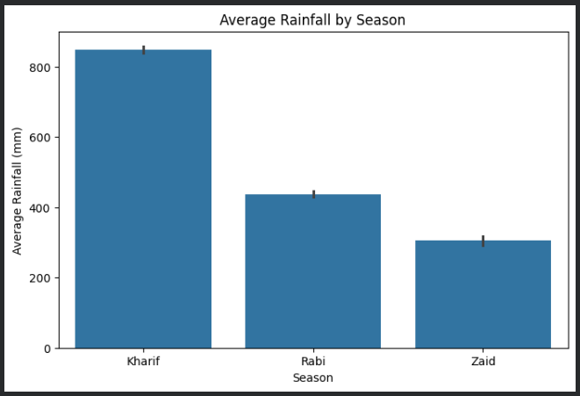
RESULTS
Environmental Analysis
Kharif received the highest average rainfall: 849.20 mm
Rabi: 437.02 mm
Zaid: 304.65 mm
Kharif also showed the highest average soil moisture and humidity.
Zaid recorded the highest average temperature.

Slide 8
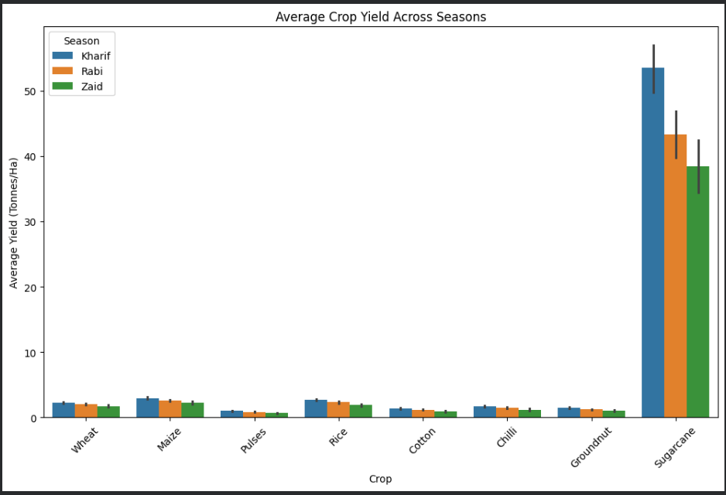
RESULTS
Crop Performance Across Seasons
Key Findings
Sugarcane recorded the highest average yield.
Kharif generally showed higher crop yields than Rabi and Zaid.
Sugarcane maintained the highest yield across all three seasons.
Crop performance varies considerably by crop and season.

Slide 9
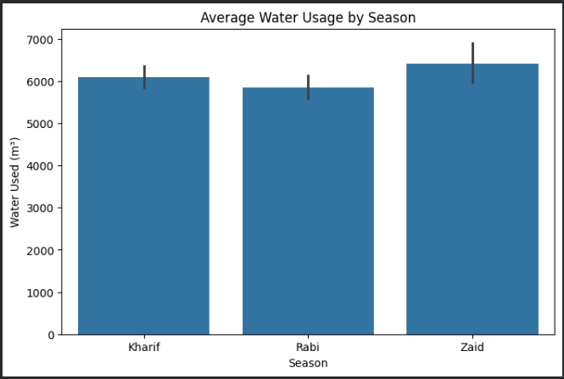
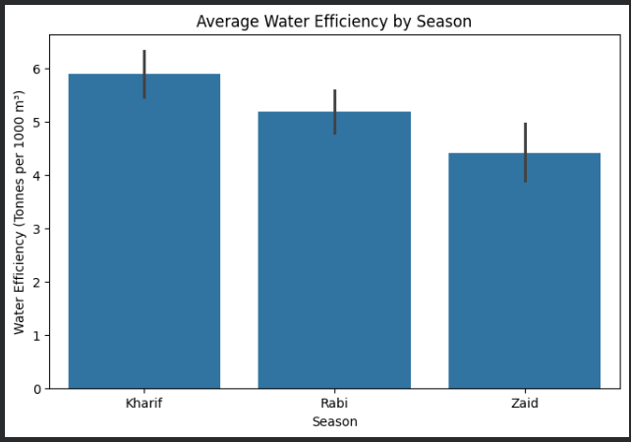
RESULTS
Resource & Water Analysis
Water Usage
Kharif: 6,102 m³
Rabi: 5,847 m³
Zaid: 6,420 m³
Water Efficiency
Kharif: 5.89 T/1,000 m³
Rabi: 5.19 T/1,000 m³
Zaid: 4.41 T/1,000 m³

Slide 10
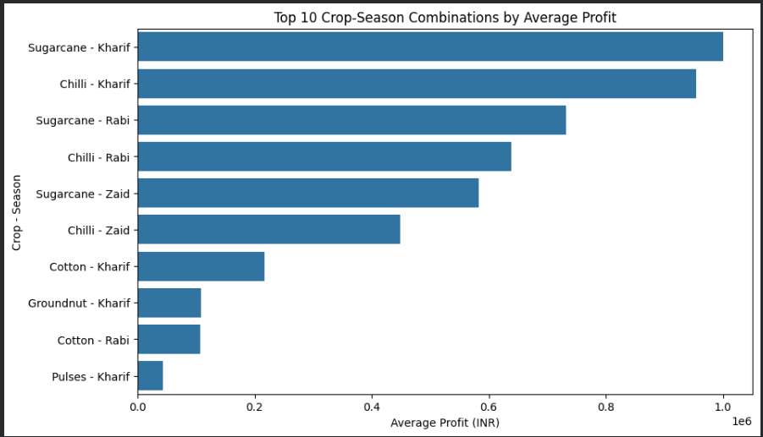
RESULTS
Economic & Statistical Analysis
Economic Finding
Kharif
→ Highest average profit: ₹1.79 lakh
Rabi
→ Average profit: ₹0.88 lakh
Zaid
→ Average loss: ₹0.25 lakh
Statistical Finding
Seasonal Profit ANOVA
p-value = 1.71 × 10⁻¹⁵
Since:
p < 0.05
there is strong statistical evidence that average profit differs across seasons.
Seasonal yield ANOVA: p = 0.2137

Slide 11
Future scope
Future Scope
1. Predictive Analytics
Develop models to predict crop yield and profitability.
2. Weather Integration
Incorporate real-time weather and rainfall data.
3. Regional Analysis
Compare agricultural performance across states and districts.
4. Advanced Resource Optimization
Analyze optimal water, fertilizer and pesticide usage.
5. Interactive Dashboard
Develop a dashboard for farmers and agricultural planners.
6. Time-Series Analysis
Study agricultural performance across multiple years.

Slide 12
GitHub Link
https://github.com/SK-P-BibiAyesha/Seasonal-Agriculture-Performance-Analysis

Slide 13
Thank you
Seasonal Agriculture Performance Analysis
Data Analytics Project
SHAIK PATTA BIBI AYESHA
.
.

